Slide 1
Component Analyzer
Nathaniel Wendt

Slide 2
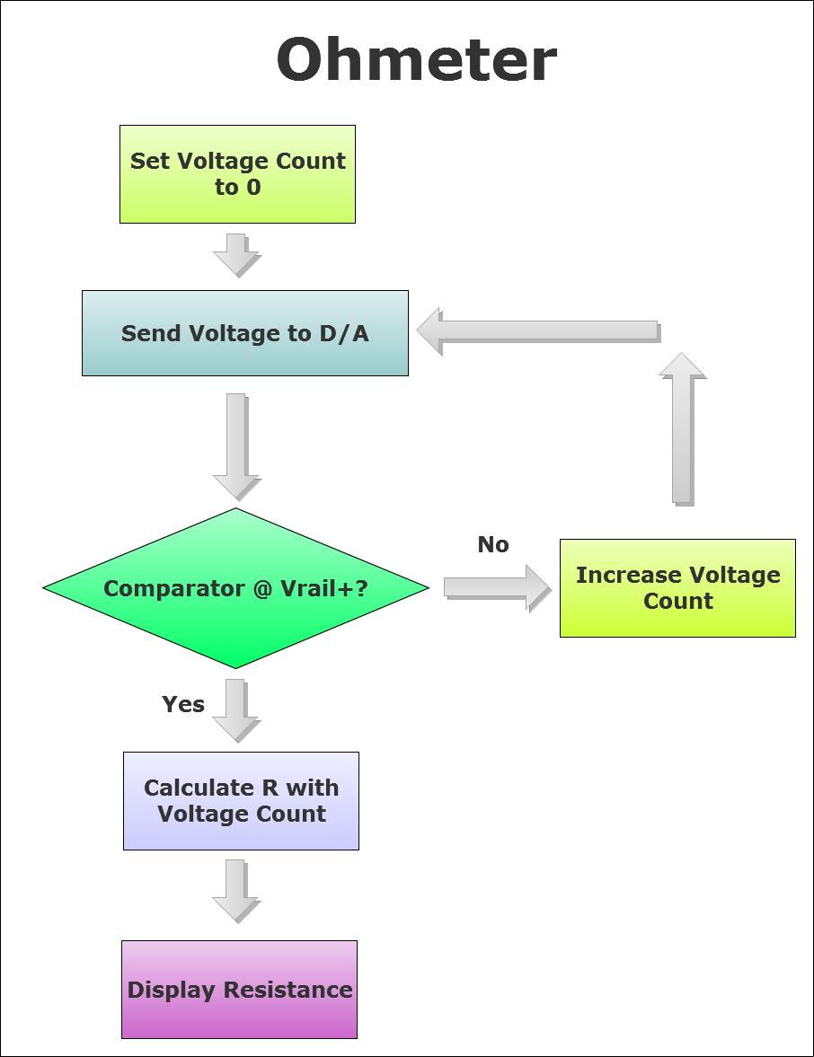

Slide 3
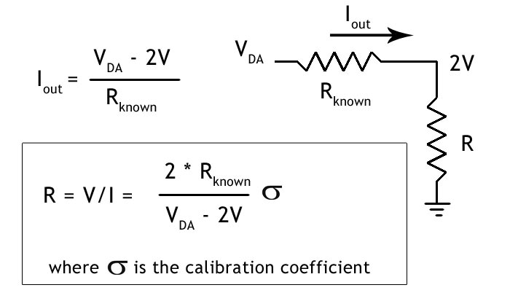

Slide 4
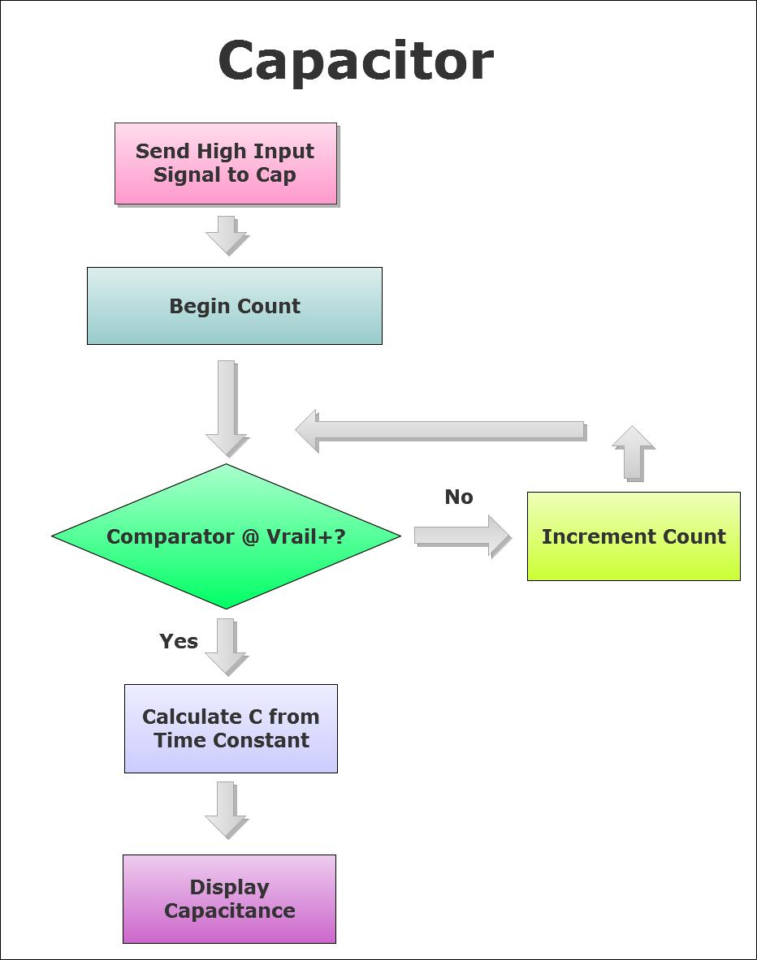

Slide 5
Range & Tolerance
Resistance
100 Ω - 36 kΩ 4%
Capacitance
100nF – 33uF 10%
*20nF reads 38 nf
*47uF reads 54uF

